Slide 1
Dept. of Communication Engineering College of Engineering- University of Diyala Lecture No.: 1
2nd year Class
MATLAB programming language Lec. Jinan N. Shehab
Chapter Two MATLAB Expressions
Like most other programming languages, the MATLAB language provides mathematical expressions, but unlike most programming languages, these expressions involve entire matrices. The building blocks of expressions are:-
Variables
Numbers
Data Type
Operators
Functions
Algebraic or Symbolic Computation
2.1 variables:-
MATLAB does not require any type declarations or dimension statements. When MATLAB encounters a new variable name, it automatically creates the variable and allocates the appropriate amount of storage. If the variable already exists, MATLAB changes its contents and, if necessary, allocates new storage. For example:-
num_students = 25
creates a 1-by-1 matrix named num_students and stores the value 25 in its single element. To view the matrix assigned to any variable, simply enter the variable name. As we saw in the
previous example, the names assigned to variables have to follow some basic rules. In
MATLAB the rules for variable names are as follows:
Variable names must start with a letter.
Names can only be based on the letters A-Z & a-z, numbers 0-9 and underscore _.
Only the first 31 characters in a variable name are recognized by MATLAB.
Names are case sensitive: name, Name, NAME are different.
Examples of valid variable names: r2d2, pay_day
Examples of invalid names : pay-day , 2a , name$ , _2a 2.2 Numbers:-
MATLAB uses conventional decimal notation, with an optional decimal point and leading plus or minus sign, for numbers. Scientific notation uses the letter (e) to specify a power-of- ten scale factor. Imaginary numbers use either i or j as a suffix. Some examples of legal numbers are:-
3 | -99 | 0.0001
9.6397238 | 1.60210e-20 | 6.02252e23
1i | -3.14159j | 3e5i
MATLAB stores all numbers internally using the long format specified by the IEEE® floating- point standard. Floating-point numbers have a finite precision of roughly 16 significant decimal digits and a finite range of roughly 10⁻³⁰⁸ to 10⁺³⁰⁸.

Slide 2
Dept. of Communication Engineering College of Engineering- University of Diyala Lecture No.: 1
2nd year Class
MATLAB programming language Lec. Jinan N. Shehab
MATLAB supports the following special variables and constants:
i and j can be used to indicate complex numbers (√−1).
pi has the value 3.1415926…
eps floating-point relative precision, 2⁻⁵²=2.2204e-016
realmin smallest floating point number, 2⁻¹⁰²²= 2.2251e-308
inf infinity
ans stores the last unassigned value (like on a calculator)
Inf and –Inf are positive and negative infinity
NaN represents ‘Not a Number’
MATLAB allows operations involving complex numbers. Complex numbers are entered using function i or j. For example, a number z = 2 + j2 may be entered in MATLAB as:-
z = 2+2*i or z = 2+2*j
Also, a complex number za:-
za = 2 √2 exp[(π / 4) j] can be entered in MATLAB as:-
>> za = 2*sqrt(2)*exp((pi/4)*j)
Note:-the function names are not reserved. It is possible to overwrite any of them with new variable such as:-
>> pi=500
pi= 500
The original function can be restored with:-
>> clear pi %clear use to erase the values of any variables, or restore the default one
>> pi ans= 3.1416
2.3 Data Type Available in Matlab:-
MATLAB provides 15 fundamental data types. Every data type stores data that is in the form of a matrix or array. The size of this matrix or array is a minimum of 0-by-0 and this can grow up to a matrix or array of any size. The following table shows the most commonly used data types in MATLAB:

Slide 3
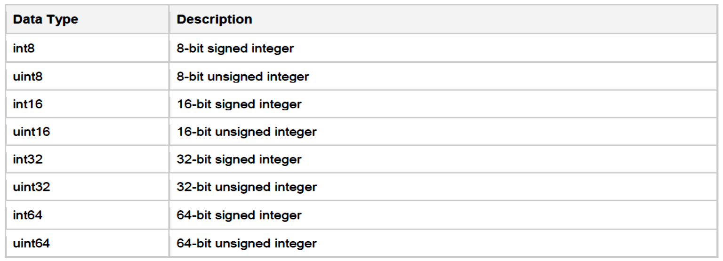
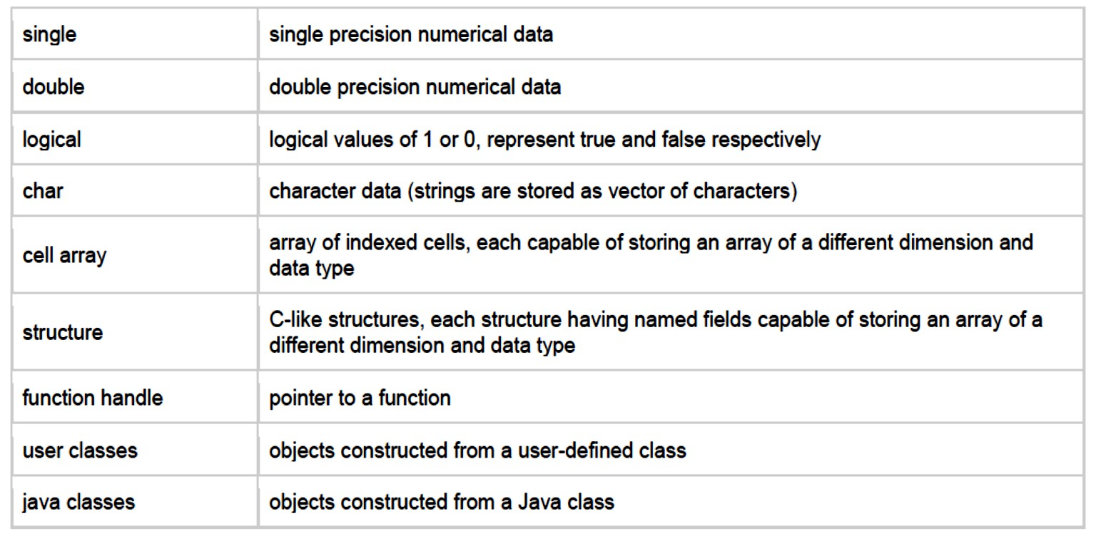
Dept. of Communication Engineering College of Engineering- University of Diyala Lecture No.: 1
2nd year Class
MATLAB programming language Lec. Jinan N. Shehab
>> uint8(2^8) ans =
255
% 2^8 = 25.
>> a= double(2.3*5.66)
>> uint8(a)
Operators:-
An operator is a symbol that tells the compiler to perform specific mathematical or logical manipulations. MATLAB is designed to operate primarily on whole matrices and arrays. Therefore, operators in MATLAB work both on scalar and non-scalar data. MATLAB allows the following types of elementary operations:
Arithmetic Operators
Relational Operators
Logical Operators

Slide 4
Dept. of Communication Engineering College of Engineering- University of Diyala Lecture No.: 1
2nd year Class
MATLAB programming language Lec. Jinan N. Shehab
Bitwise Operations
Set Operations
Arithmetic Operators:-
MATLAB allows two different types of arithmetic operations:
Matrix arithmetic operations
Array arithmetic operations
2.4.1.1 Matrix arithmetic operation:-
precedence | operator | Matlab function | Descriptions | Algebraic form |  | Matlab | Answer
8 | + | plus(a,b) | Addition | 3+9 |  | 3+9 | 12
7 | - | minus(a,b) | Subtraction | 9-6 |  | 9-6 | 3
6 | * | mtimes(a,b) | Multiplication | 5×25 |  | 5*25 | 125
5 | / | mrdivide(a,b) | Division |  | 1 2 | 2\1 | 0.5
4 | \ | mldivide(a,b) | Left division |  | 4 2 | 4/2 | 2
3 | ^ | mpower(a,b) | Power | ₃2 |  | 3^2 | 9
2 | ' | ctranspose(a) | Complex conjugate transpose | (2+5j)^{t} |  | 5*j' | 2.000- 5.000j
1 | ( ) |  | Specify evaluation order | (3+1)× 2 |  | (3+1)*2 | 8
Examples:-
1.
In Matlab, it become:-
>> 1/(2+3^2)+4/5*6/7
ans= 0.7766
Or, if parentheses is missing:-
>>1/2+3^2+4/5*6/7
ans= 10.1857
2 2
2.
� − �
𝑑²+17
>> (a^2-b^2)/(d^2+17) 3. (3+2i)+(5+4j)
>> 3+2i+5+4j

Slide 5
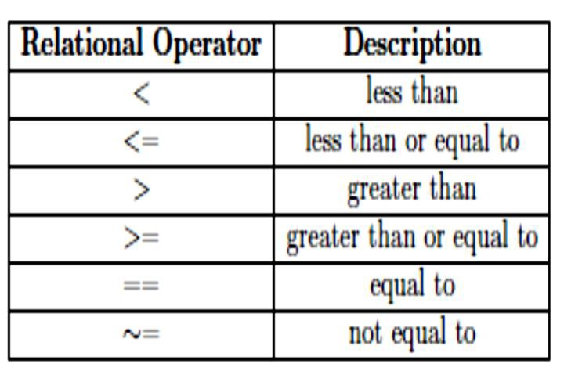
Dept. of Communication Engineering College of Engineering- University of Diyala Lecture No.: 1
2nd year Class
MATLAB programming language Lec. Jinan N. Shehab
ans= 8.0000+6.00001
4. solve the equations:-
𝑐4 =
(𝑐1 + 𝑐2)
�ℎ𝑒𝑟𝑒𝑐1 = 1 + 𝑗2, 𝑐2 = −𝑗9, 𝑐3 = 𝑗1.4142.
𝑐3
>>c1=1+2*i; c2=-9*i; c3=1.4142i;
>>c4=(c1+c2)/c3 c4=
-4.9498-0.7071i
5. 3²-(5+4)/2+6×3
>> 3^2-(5+4)/2+6*3
ans= 22.5000
MATLAB prints the answer and assigns the value to a variable called ans. If you want to perform further calculations with the answer, you can use the variable ans rather than retype
the answer. For example, you can compute the sum of the square and the square root of the previous answer as follows:-
>> ans^2+sqrt(ans) Ans=
510.9934.
2.4.2 Relational Operators:-
Relational operators can also work on both scalar and non-scalar data. Relational operators for arrays perform element-by-element comparisons between two arrays and return a logical array of the same size, with elements set to logical 1 (true) where the relation is true and elements set to logical 0 (false) where it is not. The following table shows the relational operators available in MATLAB:

Slide 6
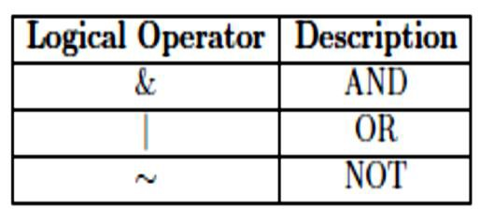
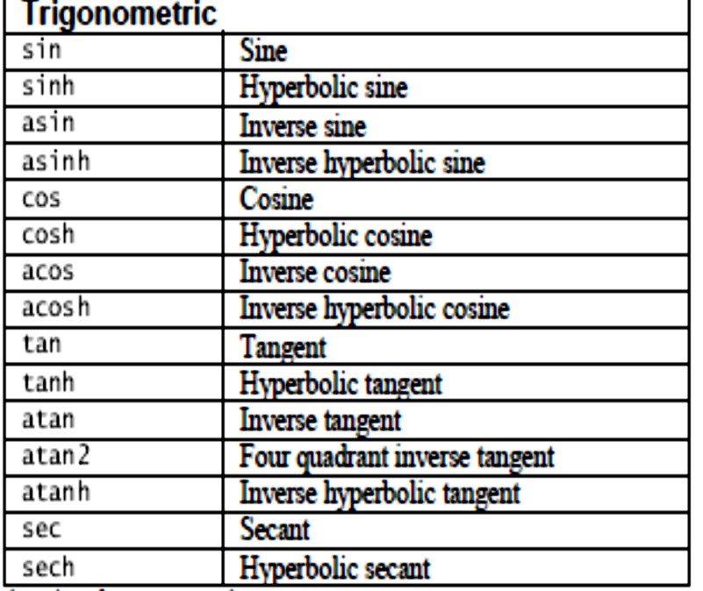
Dept. of Communication Engineering College of Engineering- University of Diyala Lecture No.: 1
2nd year Class
MATLAB programming language Lec. Jinan N. Shehab
2.4.3 Logical Operators:-
Logical operators allow us to combine a series of relational expression.
2.5 Functions:-
MATLAB provides a large number of standard elementary mathematical functions, including abs, sqrt, exp, and sin. Taking the square root or logarithm of a negative number is not an error; the appropriate complex result is produced automatically. MATLAB also provides many more advanced mathematical functions, including Bessel and gamma functions. Most of these functions accept complex arguments. In MATLAB you will use both built-in functions and functions that you create yourself. So we classify the elementary mathematical function into:-
2.5.1 Trigonometric Functions:-
>>sin(pi/4) ans= 0.7071
>> a=7; b=cos(a), c=cosh(a) b =
0.6570
c = 548.3170

Slide 7
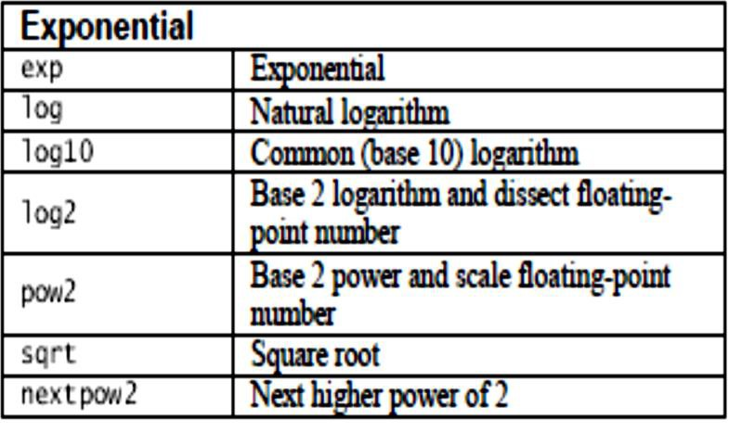
Dept. of Communication Engineering College of Engineering- University of Diyala Lecture No.: 1
2nd year Class
MATLAB programming language Lec. Jinan N. Shehab
2.5.2 Exponential Functions:-
As a first example, the value of the expression y = e−a sin(x) + 10√y, for a = 5, x = 2, and
y = 8 is computed by:-
>> a = 5; x = 2; y = 8;
>> y = exp(-a)*sin(x)+10*sqrt(y) y =
28.2904
The subsequent examples are
>> log(142) ans = 4.9558
>> log10(142)
ans = 2.1523 .
solve the following mathematical expression in MATLAB :- ln(2𝜋+ √4𝜋² − 1)
>> log (2*pi+sqrt(4*pi^2-1)) ans=
2.5246
Note:-
The function log is the natural logarithm, called "ln" in many texts.
Trigonometric functions in MATLAB use radians, not degrees. And to convert the angle from radian to degree we can use the following:-
>> sind(30)
ans =
0.5000
>> deg2rad(ans) ans =
0.0087
>> rad2deg(ans)

Slide 8
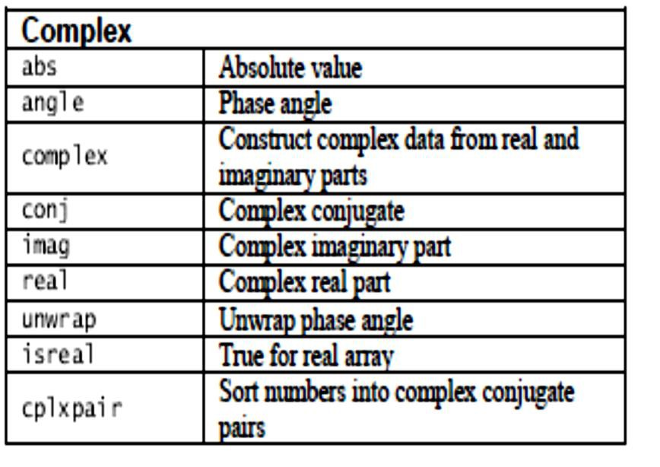
Dept. of Communication Engineering College of Engineering- University of Diyala Lecture No.: 1
2nd year Class
MATLAB programming language Lec. Jinan N. Shehab
ans =
0.5000
2.5.3 Complex Function:-
Example:- if z is acomplex number z=3+4i then:-
>> real(z) ans=
3
>> imag(z) ans=
4
>> conj(z) ans=
3.0000- 4.0000i
>> abs(z) ans=
5
>> angle(z) ans= 0.9273

Slide 9
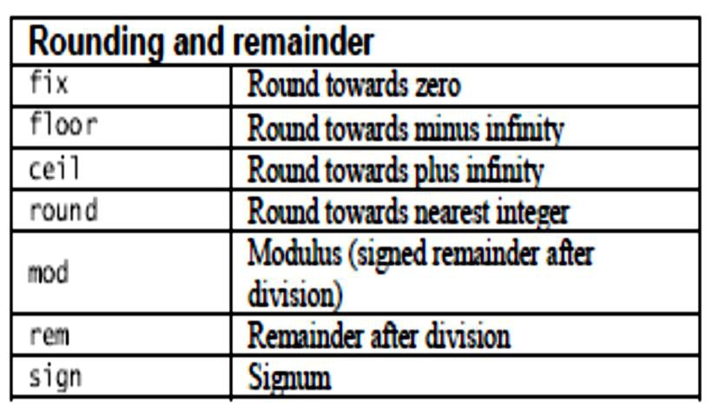
Dept. of Communication Engineering College of Engineering- University of Diyala Lecture No.: 1
2nd year Class
MATLAB programming language Lec. Jinan N. Shehab
2.5.4 Rounding and remainder Function:-
Note:- mod(x,y) and rem(x,y) are equal if x and y have the same sign, but differ by y if x and y have different sign.
>> mod(-3,2)
ans =
1
>> rem(-3,2)
ans =
-1
2.5.5 User Functions:-
Some of the functions, like sqrt and sin, are built in. they are part of Matlab core, but you may want to implement your own function in M-files and even modify it if you want. User-defined functions (i.e., those no pre-programmed in Matlab) can be defined by using an m-file. These files are simply text files whose name end with the suffix .m. Those m-files that a user may create are typically stored in the work directory. This directory is the default working directory of a Matlab installation. Functions defined by m files start with the line:-
function [assignment variable(s)] = function name(arguments) function is a required Matlab particle to identify the file as a function, assignment variable(s) is an optional dummy variable.
function name is the name given to the function, and
arguments are optional values passed on to the function from the main Matlab interface or from within another function.
Example: - apply ohm law when the value of voltage and resistant are known?
Solution:-
- Open new M-file (choose new script) and write the following statements:- 1-function I= current (V,R)
2-I=V/R;

Slide 10
Dept. of Communication Engineering College of Engineering- University of Diyala Lecture No.: 1
2nd year Class
MATLAB programming language Lec. Jinan N. Shehab
Save the M-file ( from Save choose Save as) with same function name( current) and run it( Run) then call the function (current) in command window and pass current arguments (V,R) to calculate I:-
>> current (220,12) ans=
18.3333
This function can use in any time and any position
>> I1=current (220,10) I1=
22
>> I2= current (220,20) I2=
11
2.6 Algebraic or Symbolic Computation:-
Symbolic objects are a special MATLAB data type introduced by the Symbolic Math Toolbox software. They enable you to perform mathematical operations in the MATLAB workspace analytically, without calculating numeric values. You can use symbolic objects to perform a wide variety of analytical computations:
Differentiation, including partial differentiation
Definite and indefinite integration
Taking limits, including one-sided limits
Summation, including Taylor series
Matrix operations
Solving algebraic and differential equations
Variable-precision arithmetic
Integral transforms
To declare variables x and y as symbolic objects use the syms command:
>> syms x y
You can manipulate the symbolic objects according to the usual rules of mathematics. For example:
>> z=x ^2-2*x*y+y
z=
x ^2-2*x*y+y
>> z*2 ans=
2*x^2-4*y*x+2*y
>> z/2 ans=
x^2/2-y*x+y/2
>> z-2
10

Slide 11
Dept. of Communication Engineering College of Engineering- University of Diyala Lecture No.: 1
2nd year Class
MATLAB programming language Lec. Jinan N. Shehab
ans=
x^2-2*y*x+y-2
>>5*y*z ans=
5*y*(x^2-2*x*y+y)
Example: Evaluate the following equation in symbolic expression:- (x-y)(x-y)² Solution:-
>> syms x y
>> (x-y)*(x-y)^2 ans=
(x-y)^3
>> expand (ans) ans=
x^3-3*x^2*y+3*x*y^2-y^3
>> factor(ans) ans=
(x-y)^3
The command expand told MATLAB to multiply out the expression, and factor forced MATLAB to restore it to factored form.
2.6.1 Differentiate Symbolic Expressions:-
With the Symbolic Math Toolbox software, you can find
Derivatives of single-variable expressions
Partial derivatives
Second and higher order derivatives
Mixed derivatives
first derivative:-
To differentiate a symbolic expression, use the diff command. The following example illustrates how to take a first derivative of a symbolic expression:-
Example:- find dy/dx if f=sin²(x)?
solution:-
>> syms x
>> f = sin(x)^2;
>> diff(f) ans =
2*cos(x)*sin(x)
Second and higher-order derivatives:-
Example:- find y'& y'' if y= sin 2x? Solution:-
>> syms x
Diyala university- College of Engineering
11

Slide 12
Dept. of Communication Engineering College of Engineering- University of Diyala Lecture No.: 1
2nd year Class
MATLAB programming language Lec. Jinan N. Shehab
>> y= sin (2*x);
>> diff(y) ans= 2*cos(2*x)
>> diff(y,2)
ans=
(-4)*sin(2*x)
Example:- find four derivatives of y= x³-3x²+2 Solution:-
>> syms x
>> y=x^3-3*x^2+2 y =
x^3 - 3*x^2 + 2
>> diff(y,4) ans =
0
If we said find y' and y'' and y''' and y'''' then the solution become:-
>> syms x
>> y=x^3-3*x^2+2 y =
x^3 - 3*x^2 + 2
>> diff(y) ans = 3*x^2 - 6*x
>> diff(y,2)
ans = 6*x - 6
>> diff(y,3) ans =
6
>> diff(y,4) ans =
0
2.6.1.3 Partial derivatives:-
For multivariable expressions, you can specify the differentiation variable. If you do not specify any variable, MATLAB chooses a default variable by its proximity to the letter x:-
Example:- find 𝝏� & 𝝏� of the following function:-
𝝏� 𝝏�
�(�. �) = �^{��+��}

Slide 13
Dept. of Communication Engineering College of Engineering- University of Diyala Lecture No.: 1
2nd year Class
MATLAB programming language Lec. Jinan N. Shehab
Solution:-
>> syms x y
>> z=exp(x^2+y^2);
>> diff(z,x) ans =
2*x*exp(x^2 + y^2)
>> diff(z,y) ans =
2*y*exp(x^2 + y^2)
2.6.1.4 second and higher order of partial derivatives:-
Example:- if f(x,y)=ye^{x}+x , find f_{x}, f_{xx}, f_{y}, f_{yy}, f_{xy}, f_{yx}? Solution:-
>> syms x y
>> z=exp(x^2+y^2);
>> diff(z,x) ans =
2*x*exp(x^2 + y^2)
>> diff(z,y) ans =
2*y*exp(x^2 + y^2)
>> syms x y
>> f=y*exp(x)+x;
>> diff(f,x) ans = y*exp(x) + 1
>> diff(f,x,2)
ans = y*exp(x)
>> diff(f,y) ans = exp(x)
>> diff(f,y,2) ans =
0
>> diff(diff(f,x),y) ans =
exp(x)
>> diff(diff(f,y),x) ans =
exp(x)

Slide 14
Dept. of Communication Engineering College of Engineering- University of Diyala Lecture No.: 1
2nd year Class
MATLAB programming language Lec. Jinan N. Shehab
2.6.2 Integrate Symbolic Expressions
Example:- find the function for the derivative y'=2cos2x? Solution:-
>> syms x
>> f=2*cos(2*x);
>> y=int(f) y =
sin(2*x)
�
Example:- evaluate � = ∫� √� + 𝐜𝐨𝐬� ��
Solution:-
>> syms x
>> f= sqrt(1+cos(x)) f =
(cos(x) + 1)^(1/2)
>> y=int(f,0,1) y =
2*2^(1/2)*sin(1/2)
MATLAB can also do multiple integrals. The following command computes the double
𝝅𝒔𝒊𝒏�
(�� + ��) �� �� ∶
integral:- ∫� ∫�
>> syms x y; int(int(xˆ2 + yˆ1, y, 0, sin(x)), 0, pi)
ans = pi^2-32/9
MATLAB has command called simplify. Which you can sometimes use to express a formula as simply as possible, for example:-
>> simplify((x^3-y^3)/(x-y)) ans=
x^2+x*y+y^2
2.6.3 Substitutions in Symbolic Expressions:-
2.6.3.1 Substitute Symbolic Variables with Numbers
You can substitute a symbolic variable with a numeric value by using the subs function.
Example: - evaluate the symbolic expression f at the point x = 1/3?

Slide 15
Dept. of Communication Engineering College of Engineering- University of Diyala Lecture No.: 1
2nd year Class
MATLAB programming language Lec. Jinan N. Shehab
Solution:-
>>syms x
>>f = 2*x^2 - 3*x + 1;
>>subs(f, 1/3) ans =
2/9
% The subs function does not change the original expression f:-
>> f f =
2*x^2 - 3*x + 1
Substitute in Multivariate Expressions
When your expression contains more than one variable, you can specify the variable for which you want to make the substitution. For example, to substitute the value x = 3 in the symbolic expression:-
>> syms x y
>> f = x^2*y + 5*x*sqrt(y);
>> subs(f, x, 3) ans =
9*y + 15*y^(1/2)
Substitute One Symbolic Variable for Another:-
You also can substitute one symbolic variable for another symbolic variable. For example to replace the variable y with the variable x. for example; f= x²y+5x√�
>> syms x y
>> f = x^2*y + 5*x*sqrt(y);
>> subs(f, y, x) ans =
x^3 + 5*x^(3/2)
H.W:-
1- w.p to calculate the value of y and y' for (x=2) when y= 3x²+14x-5 2-w.p to find the value of y when x=3, a=2, b=-3 and c=9.
2.6.4 Limits
You can use limit to compute right- and left-handed limits and limits at infinity. For example, here is lim sin(�) /�:
𝑥→0
>> syms x; limit(sin(x)/x, x, 0)
ans = 1

Slide 16
Dept. of Communication Engineering College of Engineering- University of Diyala Lecture No.: 1
2nd year Class
MATLAB programming language Lec. Jinan N. Shehab
To compute one-sided limits, use the ’right’ and ’left’ options. For example,
>> limit(abs(x)/x, x, 0, ’left’)
ans =
-1
Limits at infinity can be computed using the symbol Inf:
>> limit((xˆ4 + xˆ2 - 3)/(3*xˆ4 - log(x)), x, Inf)
ans =
1/3
2.6.5 Symbolic Expressions, Variable precision, and exact arithmetic:-
As we have noted, MATLAB uses floating point arithmetic for its calculations. Using the Symbolic Math Toolbox, you can also do exact arithmetic with symbolic expressions. Consider the following example:
>> cos(pi/2) ans = 6.1232e-17
The answer is written in floating point format and means 6.1232 × 10⁻¹⁷. However, we know that cos(π/2) is really equal to 0. The inaccuracy is due to the fact that typing pi in MATLAB gives an approximation to π accurate to about 15 digits, not its exact value. To compute an
exact answer, instead of an approximate answer, we must create an exact symbolic representation of π/2 by typing sym(’pi/2’). Now let’s take the cosine of the symbolic representation of π/2:
>> cos(sym(’pi/2’))
ans = 0
This is the expected answer. The quotes around pi/2 in sym(’pi/2’) create a string consisting
of the characters pi/2 and prevent MATLAB from evaluating pi/2 as a floating point number. The command sym converts the string to a symbolic expression. The commands sym and syms are closely related. In fact, syms x is equivalent to x = sym(’x’). The command syms has a lasting effect on its argument (it declares it to be symbolic from now on), while sym has only a temporary effect unless you assign the output to a variable, as in x = sym(’x’). Here is how to add 1/2 and 1/3 symbolically:
>> sym(’1/2’) + sym(’1/3’)
ans = 5/6
Finally, you can also do variable-precision arithmetic with vpa. For example, to print 50 digits
of √2, type
>> vpa(’sqrt(2)’, 50)
ans = 1.4142135623730950488016887242096980785696718753769

Slide 17
Dept. of Communication Engineering College of Engineering- University of Diyala Lecture No.: 1
2nd year Class
MATLAB programming language Lec. Jinan N. Shehab
If you don't specify the number of digits, the default setting is 32. You can change the default with the command digits.
To illustrate, evaluate the expressions:-
>> 3^45
ans= 2.9543e+021
>> vpa(3^45)
ans= 2954312706550833610752.0
>> vpa('3^45') ans=
2954312706550833698643.0
You should be wary of using sym or vpa on an expression that MATLAB must evaluate before applying variable-precision arithmetic. To illustrate, enter the expressions 3ˆ45, vpa(3ˆ45), and vpa(’3ˆ45’). The first gives a floating point approximation to the answer, the second — because MATLAB only carries 16-digit precision in its floating point evaluation of the exponentiation —gives an answer that is correct only in its first 16 digits, and the third gives the exact answer.

